Slide 1
Constructors
A constructor (default and/or class) creates an object of a class
Here is an example of a constructor:
public Customer(int id, String name)
{ … }
It takes an int and a String object as parameters
We call it like this:
Customer customerOne = new Customer(1, “Jo”);

Slide 2
Assigning Attributes
Parameters to a constructor usually set the values of attributes for an object
It is done inside the constructor
public Customer(int id, String name)
{
this.id = id;
this.name = name;
}
this is a keyword in Java that refers to the current object ie the object with datatype Customer that is being created by the constructor

Slide 3
Assigning Attributes
We could have also done this
public Customer(int theId, String theName)
{
id = theId;
name = theName;
}
Note: the parameters have different names to the attributes, so we do not need to differentiate between the attribute (of the object) and the constructor parameter.

Slide 4
Local Variables
Local variables support method encapsulation; if a value is used only inside a method, make it local, don't make it an attribute.
A local variable is declared inside a method.
It is temporary; it exists only inside the block where it is declared.
The scope of a variable is the area where it can be seen and used.
The scope may be less than a method eg a variable may only exist inside a loop
The scope of a local is the block where it is declared.

Slide 5
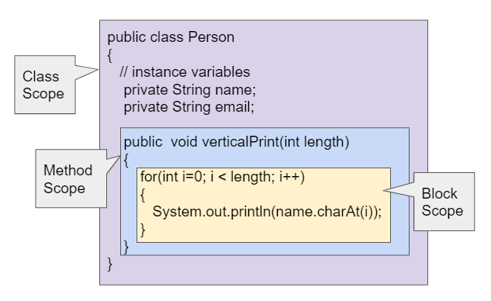
Variable Scope
Variables name & email can be used in the whole class.
Variable length can be used in verticalPrint() ONLY
Variable i can be used in the for loop ONLY
Image: Runestone Academy. (2021, July 19) Scope and Access, https://csawesome.runestone.academy/runestone/books/published/csawesome/Unit5-Writing-Classes/topic-5-8-scope-access.html

Slide 6
Parameters
A parameter is a local variable; its scope is the method.
It is created when the method is called, exists while the method is executing, and disappears when the method exits.
The method call supplies one value for each parameter; the value is called an argument.

Slide 7
Parameter Binding
Parameters are bound in order; the first parameter gets the first argument, the second parameter gets the next value (argument), and so on.
Method calls supply values (arguments); method headers supply variables (parameters).
Find the matching method
Create local variables for the parameters
Bind the parameters to the argument values
Use the parameters inside the method
Delete the parameters when the method exits

Slide 8
Calling Constructors
When we create an object we call the class constructor.
We must supply the values of the parameters
Constructor:
public Employee(int id, String email)
{
this.id = id;
this.email = email;
}
Calling constructor to create an object:
Employee emp1 = new Employee(1, “j@gmail.com”);

Slide 9
Calling void Methods
When we call void methods, sometimes we must supply the values of the parameters also.
public void setEmail(String email)
{
this.email = email;
}
Calling :
emp1.setEmail(“bob@gmail.com”);

Slide 10
Calling Non-void Methods
When we call non-void methods, we must supply the values of the parameters AND assign the returned value to a variable.
public String getEmail()
{
return email;
}
Calling:
String address = emp1.getEmail();

Slide 11
Objects as Parameters
We can even pass objects as parameters.
Method:
public void display(Employee e1)
{
e1.display();
}
Calling display method:
Employee emp1 = new Employee(1, “j@gmail.com”);
display(emp1);

